Slide 1
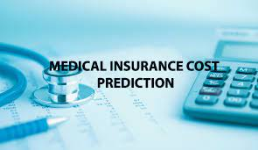

Medical Insurance Cost Prediction using Machine Learning with Python
Group Members:
NAME, COLLEGE NAME, UNIVERSITY ROLL NUMBER
NAME, COLLEGE NAME, UNIVERSITY ROLL NUMBER
NAME, COLLEGE NAME, UNIVERSITY ROLL NUMBER
NAME, COLLEGE NAME, UNIVERSITY ROLL NUMBER
NAME, COLLEGE NAME, UNIVERSITY ROLL NUMBER
1

Slide 2

Table of Contents
Acknowledgement
Project Objective
Project Scope
Data Description
Model Building
Code
Future Scope of Improvements
Project Certificate
2

Slide 3
Acknowledgement
I take this opportunity to express my profound gratitude and deep regards to my faculty (fill in your Professor / Mentor / Faculty Name) for his exemplary guidance, monitoring and constant encouragement throughout the course of this project. The blessing, help and guidance given by him/her time to time shall carry me a long way in the journey of life on which I am about to embark.
I am obliged to my project team members for the valuable information provided by them in their respective fields. I am grateful for their cooperation during the period of my assignment.
Name
3

Slide 4

Project Objective
Problem Statement
Here we can create, an automatic system where a system collects data from a person and predict the cost of the Medical Insurance, that analyse how much will be the cost. We will use linear regression,
What is objective
First We collect the Insurance Cost from various persons, then we will predict the cost of the insurance.
4

Slide 5
Work Flow
First we will collect the insurance cost data from the dataset, then we will do some data analysis, so we need to analyse this data to understand whether it give us some meaning that what is this data all about, then next is data pre processing, when we get the data, we cannot feed it directly to machine learning algorithm, this is where data pre-processing comes into play, so once we process the data, it will compatible to go into the machine learning model. Next step will be split our data into training data and testing data. In Machine learning, we train our machine learning model with this training data and evaluate our model with test data, so this will see how model is performing and check the performance of our model, So after splitting this data, we feed this data to our machine learning model, here we will use linear regression model, when we train this model, we will evaluate this model to check how it is well performing, after that we will have a trained linear regression model, once we have that, we can feed new data and once we feed this new data this model that predict what is the insurance cost will be it.
Linear Regression model is most of a statistical model than machine learning model.

Slide 6
Project Scope
Project Scope:- Medical Insurance Cost Prediction using Machine Learning with Python
1) The system will be available on an online platform accessible to all people.
2) The system will collect insurance data and check the information to give the prediction.
6

Slide 7
Introduction
We live on a planet full of threats and uncertainty. Including People, households, durables, properties are exposed to different risks and the risk levels can vary. These risks range from risk of health diseases to death if not get protection, and loss in property or assets. But, risks cannot usually be avoided, so the world of finance has developed numerous products to shield individuals and organizations from these risks by using financial capital to shield them. Therefore Insurance is one of the policies that either decreases or removes loss costs incurred by various risks. The value of insurance in the lives of individuals. That's why it becomes important for insurance companies to be sufficiently precise to measure the amount covered by this specific policy and the insurance charges which must be paid for it. Various parameters or factors play an important role in estimating the insurance charges and Each of these is important. If any factor is omitted or changed when the amounts are computed then, the overall policy cost changes. It is therefore very critical to carry out these tasks with high accuracy. So, the possibility of human mistakes are high so insurance agents also use different tools to calculate the insurance premium. And thus ML is beneficial here. ML may generalize the effort or method to formulate the policy.

Slide 8
These ML models can be learned by themselves. The model is trained on insurance data from the past. The model can then accurately predict insurance policy costs by using the necessary elements to measure the payments as its inputs. This decreases human effort and resources and improves the company's profitability. Thus the accuracy can be improved with ML. Our goal is to predict insurance costs. The value of insurance fees is based on different variables. As a result, insurance fees are continuous. Regression is the best choice available to fulfill our needs. We use multiple linear regression in this analysis since there are many independent variables used to calculate the dependent(target) variable. For this study, the dataset for cost of health insurance is used .Preprocessing of the dataset done first. Then we trained regression models with training data and finally evaluated these models based on testing data. In this article, we used several models of regression, for example, multiple linear regression, Decision Tree Regression and Gradient Boosting Regression. It is found that the gradient boosting provides the highest accuracy with an r-squared value of 86.7853. The inclusion of a novel method of insurance cost estimation is the main goal of this work.

Slide 9
Data description
We had used a dataset from Kaggle Site for creating our prediction model. This dataset has 7 features and this data set has splitted into two-parts : training data and testing data. For training the model of this dataset, 80% of total data is used for training and the rest 20% is used for testing. To build a predictor model of medical insurance cost the training dataset is applied and to evaluate the regression model, test set is used.
Columns (continuous type)
age: age of primary beneficiary
STATISTICAL MEASURES
count:- 1338.000000
max:- 64.000000
min:- 18.000000
std:- 14.049960
mean:- 39.207025
9

Slide 10
bmi: Body mass index, providing an understanding of body, weights that are relatively high or low relative to height, objective index of body weight (kg / m ^ 2) using the ratio of height to weight, ideally 18.5 to 24.9
STATISTICAL MEASURES
count:- 1338.000000
max:- 53.130000
min:- 15.960000
std:- 6.098187
mean:- 30.663397
children: Number of children covered by health insurance / Number of dependents
STATISTICAL MEASURES
count:- 1338.000000
max:- 5.000000
min:- 0.000000
std:- 1.205493
mean:- 1.094918

Slide 11
charges: Individual medical costs billed by health insurance.
STATISTICAL MEASURES
count:- 1338.000000
max:- 63770.428010
min:- 1121.873900
std:- 12110.011237
mean:- 13270.422265
Columns (categorical type)
sex: insurance contractor gender, female, male
smoker: Smoking
region: the beneficiary's residential area in the US, northeast, southeast, southwest, northwest.

Slide 12
Model Building
A. Linear Regression
Linear regression analysis is used to predict the value of a variable based on the value of another variable. The variable you want to predict is called the dependent variable. The variable you are using to predict the other variable's value is called the independent variable.
This form of analysis estimates the coefficients of the linear equation, involving one or more independent variables that best predict the value of the dependent variable. Linear regression fits a straight line or surface that minimizes the discrepancies between predicted and actual output values. There are simple linear regression calculators that use a “least squares” method to discover the best-fit line for a set of paired data. You then estimate the value of X (dependent variable) from Y (independent variable).
Model Evaluation:-
RMSE :- 6182.955535
R2_Score(training):- 0.751820
R2_Score(test):- 0.745447
Accuracy(%):- 75.0%
12

Slide 13
B. Decision trees Regression
DTs are straightforward, terribly popular, fast-training, and straightforward to scan models with comparative or different strategies of learning from the data. they're fairly competent however prone to overfitting in their predictions. they'll be strong by their performance.
Model Evaluation:-
RMSE :- 4731.645479
R2_Score(training):- 0.858204
R2_Score(test):- 0.850923
Accuracy(%):- 85.0%

Slide 14
C. Random Forest Regression
Random Forest is an ensemble technique capable of performing both regression and classification tasks with the use of multiple decision trees and a technique called Bootstrap and Aggregation, commonly known as bagging. The basic idea behind this is to combine multiple decision trees in determining the final output rather than relying on individual decision trees. Random Forest has multiple decision trees as base learning models. We randomly perform row sampling and feature sampling from the dataset forming sample datasets for every model. This part is called Bootstrap.
Model Evaluation:-
RMSE :- 4606.606669
R2_Score(training):- 0.863005
R2_Score(test):- 0.858698
Accuracy(%):- 86.0%

Slide 15
D. Gradient Boosting Regression Gradient boosting algorithmic program is one among the foremost powerful algorithms within the field of machine learning. As we all know that the errors in machine learning algorithms are generally classified into 2 classes i.e. Bias Error and Variance Error. As gradient boosting is one of the boosting algorithms it's accustomed to minimize bias error of the model. Gradient boosting algorithms are often used for predicting not solely continuous target variables as a regression however additionally categorical target variables (as a Classifier). Once it is used as a regressor, the price operates as Mean square. Error (MSE) and when it is used as a classifier then the price operates as Log loss.
Model Evaluation:-
RMSE :- 4449.357579
R2_Score(training):- 0.905217
R2_Score(test):- 0.868180
Accuracy(%):- 87.0%

Slide 16
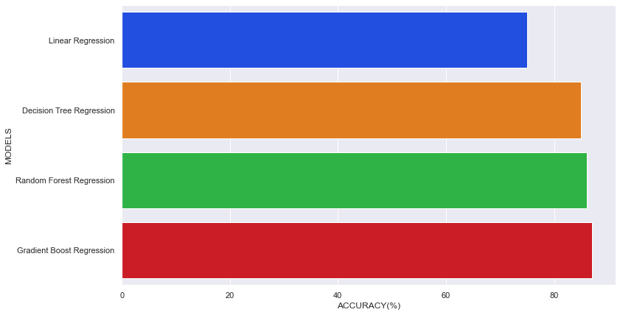
Hence After Model Evaluation And Analyzing all the Model, we can see Gradient Boost Regression has highest accuracy Model, So the finally Accepted Model for this dataset in this project is Gradient Boost Regression.

Slide 17
Implementation
The objective of the study is to prophetic the insurance cost supported age, BMI, kid number, the region of the person living, sex, and whether or not a shopper is smoking or not, drinks alcohol or not, having diabetes or not . These options contribute to our target variable prediction of insurance costs. For the measuring of the value of insurance, many regression models are applied during this study. The dataset is split into 2 sections. One half for model training and also the other part for model analysis or testing. During this study, the info set is separated into two part the first half is termed coaching knowledge and also the second called take a look at data, training data makes up for eighty percent of the whole data used, and the rest for test data. all of those models are trained with the training data part and so evaluated with the test data. The accuracy is checked with the assistance of r2 score.
17

Slide 18
Future Scope of Improvements
In this project , we discussed some of the traditional regression models for our proposed problem statement . Moving forward some of the other techniques like Support Vector Machine (SVM) , XGBoost and Stochastic Gradient Boosting needs to be addressed as the future work . Several optimization techniques such as the Genetic Algorithm or the Gradient Descent Algorithm maybe applied on top of model evaluation. We can also apply some feature selection techniques to our dataset before we train our model to gain a good accuracy value as some of the features may be omitted while predicting the charges. Besides a model to perform well a good balanced dataset with a greater number of observations is required which will reduce the variability of the model so in the future if, we get more data than the model can be trained well.
18

Slide 19
Certificate
This is to certify that Mr/Ms [fill in your name] of ASANSOL ENGINEERING COLLEGE, registration number: [fill in your university registration number], has successfully completed a project on Medical Insurance Cost Prediction using Machine Learning with Python under the guidance of Mr/Ms/Mrs [mention your faculty’s name].
----------------------------------------
[Name of your faculty]
ASANSOL ENGINEERING COLLEGE
19

